Slide 1
AI Mental Health website&MobileApp
(NAFSI)

Slide 2
Introduction
Mental health refers to a person's emotional, psychological, and social well-being. It encompasses how individuals think, feel, and behave, impacting their ability to cope with stress, form and maintain relationships, and make decisions. Good mental health is crucial for overall well-being and quality of life.
The importance of the project lies in addressing the pressing need for mental health support. Mental health issues affect a significant portion of the population, and many individuals face barriers in accessing appropriate care. Stigma, lack of resources, and limited awareness contribute to this problem.
Through the project, individuals gain access to valuable information, tools, and a supportive community, enabling them to enhance their mental well-being and seek appropriate help when required. By leveraging technology, the project aims to make mental health support more accessible, personalized, and user-friendly, thereby creating a positive impact on individuals' lives.
Nafsi is a website and mobile application designed to promote mental well-being and provide support for individuals facing various mental health challenges. The app aims to address the growing need for accessible and user-friendly mental health resources in today's fast-paced digital world.

Slide 3
Problem Definition:
Developing an Effective Mental Health Mobile App and Website
Mental health is a growing concern worldwide, with increasing numbers of individuals experiencing mental health issues such as anxiety, depression, and stress. While there is a greater awareness and acceptance of mental health concerns, access to timely and effective mental health support remains a challenge for many people. Traditional therapy options may be expensive, time-consuming, or stigmatized, preventing individuals from seeking help. In this context, the development of a mobile app focused on mental health presents an opportunity to address these barriers and provide accessible support.

Slide 4
Objectives:
Promote Self-Awareness and Emotional Regulation
2. Encourage Healthy Habits and Self-Care
3. Foster Resilience and Coping Skills
4. Support Psychoeducation and Skill Development
5. Facilitate Social Support and Connection
6. Provide Crisis Support and Emergency Resources

Slide 5
Goal: The ultimate goal of this project is to empower individuals to improve their mental well-being, enhance their self-care practices, and access appropriate support when needed. The app aims to provide a comprehensive and user-friendly platform that promotes mental health awareness, offers evidence-based resources, and fosters a sense of community. Motivation: The driving force behind our mental health project is the well-being and welfare of individuals who are facing mental health challenges. Our motivation stems from a deep understanding of the importance of mental well-being and the desire to make a positive impact on people's lives.

Slide 6
Project Development Methodology
:
Agile Methodology:
Advantages:
Flexibility
Customer Involvement
Faster Delivery
Improved Quality
Increased Transparency
Enhanced Collaboration
Early and Predictable Delivery
Quick Adaptation to Changes
Continuous Improvement
Disadvantages :
Uncertainty
Resource Intensive
Lack of Documentation
Not Suitable for All Projects

Slide 7
Tools & Technologies
Flutter
Android Studio
VS code
Back-end
VS code
Node.JS
MongoDB
Front-end
VS code
React.js
HTML
CSS
BootStrap
UI-UX
Figma
AI
VS code
Jupyter Notebook

Slide 8
Requirements
Functional Requirements:
User Registration and Authentication: Users should be able to create accounts and log in securely.
Chatbot Feature: The app should include a chatbot that engages in conversations with users, providing support, guidance, and information related to mental health.
Video Content: The app should provide a library of videos related to mental health, including educational content, guided exercises, and motivational talks.
Articles and Blog Posts: The app should offer a curated selection of articles and blog posts covering various mental health topics, self-care tips, and coping strategies.
Resource Directory: The app should include a comprehensive directory of mental health resources, such as therapists, support groups, helplines, and relevant websites

Slide 9
Non-Functional Requirements: Usability: The app and website should have an intuitive and user-friendly interface for easy navigation. Performance: The app and website should be responsive and provide fast loading times to ensure a smooth user experience. Security and Privacy: The app and website should implement robust security measures to protect user data and maintain privacy. Compatibility: The app and website should be compatible with various devices (e.g., smartphones, tablets) and operating systems (e.g., iOS, Android). Accessibility: The app and website should comply with accessibility guidelines to ensure that everyone can access and use the platform. Scalability: The app and website should be designed to handle a growing user base and increasing data without significant performance degradation.

Slide 10
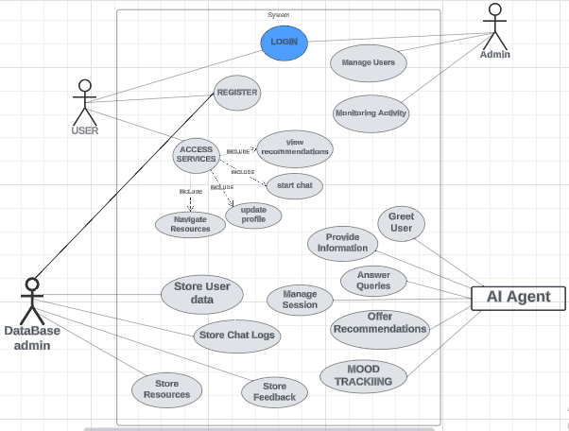

Slide 11

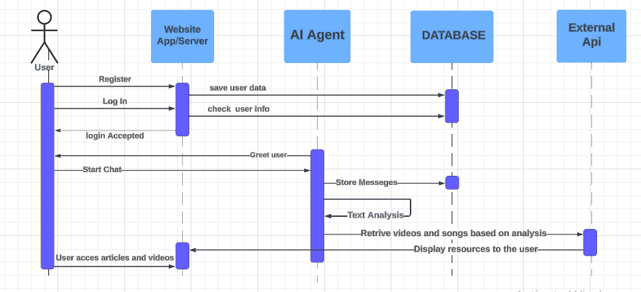
A PICTURE IS WORTH A THOUSAND WORDS

Slide 12

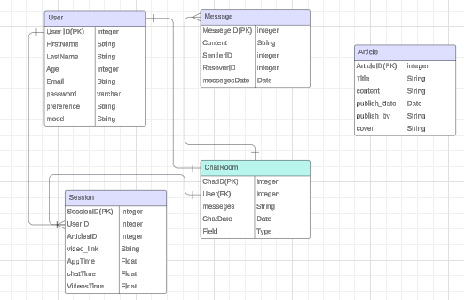
A PICTURE REINFORCES THE CONCEPT
Images reveal large amounts of data, so remember: use an image instead of long texts

Slide 13

Bugs and Dificulties
Front end :
Difficulty in adding videos from YouTube to enhance therapy content.
Solution: Resorted to using the YouTube API to fetch and embed videos dynamically. Utilized React components to seamlessly integrate video content .
Lack of proper data validation in the sign-up form.
Solution: using Formik and Yup to validate input data to prevent errors and provide an interactive user experience.
Embedding Flowise chatbot into the website using React.
Solution: Leveraged React components and the FlowiseAI API to seamlessly integrate the chatbot. Utilized state management for maintaining the dynamic interactions within the React application.

Slide 14
Encountering a blank page after building the website. Solution: It happens because it failed to render the pages into the browser. Resolved the issue by fixing React Components and use <HashRouter> instead of <BrowserRouter> .
Received a "json-server: command not found" error. Solution: Use npx to solve the error, e.g. npx json-server --watch db.json or install the package globally by running npm install -g json-server.
Compatibility Issues:
The website may not display or function properly across different web browsers (e.g., Chrome, Firefox, Safari, Internet Explorer) or devices (e.g., desktops, laptops, tablets, smartphones) due to differences in rendering engines and screen resolutions.
Solution: Conduct thorough cross-browser and cross-device testing during the development phase to identify and address rendering inconsistencies and layout issues. Use CSS frameworks like Bootstrap or Flexbox to ensure responsiveness across different screen sizes and resolutions.

Slide 15
UI-UX: Creating a Calming and Accessible UI: One of the primary challenges I faced was designing a UI that promotes a sense of calmness and accessibility for users seeking mental health support. Given the sensitive nature of the topic, it was crucial to avoid overwhelming users with too much information or cluttered interfaces. Color Psychology: To address this challenge, I opted for shades of blue throughout the app's UI. Blue is associated with feelings of calmness, trust, and stability, making it ideal for a mental health-focused application. By carefully selecting and incorporating different shades of blue, I aimed to evoke a sense of serenity and comfort for users. Chatbot Design: While the rest of the app follows a predominantly blue color scheme, I made the deliberate choice to use a white background for the chatbot interface. This decision was made to provide a visual contrast and highlight the conversational aspect of interacting with the chatbot. The white background helps to differentiate the chatbot section from the rest of the app's content, making it stand out and inviting users to engage in dialogue comfortably.

Slide 16
Balancing Functionality with Simplicity: Incorporating both media content and chatbot features while maintaining a simple and intuitive user experience posed a significant challenge. I had to ensure that users could easily navigate between different sections of the app while accessing the necessary resources without feeling overwhelmed. Horizontal and Vertical Layout: To address this challenge, I implemented both horizontal and vertical layouts within the app. This allows users to scroll horizontally to explore different categories of media content, such as articles, videos, and music. Additionally, vertical scrolling enables users to navigate within each category, accessing a variety of resources with ease. By incorporating this flexible layout design, I aimed to provide users with a seamless browsing experience that encourages exploration and discovery of relevant mental health content. Bottom Navigation Bar: In addition to the horizontal and vertical layouts, I included a bottom navigation bar for quick access to every content section. This navigation bar allows users to access different features and sections of the app with a single tap, ensuring efficient navigation and enhancing overall usability.

Slide 17
FrontEnd Tech and Techniques : Design with CSS Flexbox and Grid: Employed CSS Flexbox and Grid for creating a responsive and visually appealing user interface across various devices. Vite Framework: Is a fast and efficient build tool, enhancing the development workflow and optimizing the application's performance. FlowiseAI: Integrated FlowiseAI for embedding an intelligent chatbot, enriching the user experience with dynamic and personalized interactions. Dynamic Pages with Route Parameters and Hooks: Utilized React-Router v6, useParams, and the useFetch hook to create dynamic pages with route parameters, fetching and displaying content based on user interactions.

Slide 18
React-Router v6: Adopted React-Router v6 for efficient client-side routing, providing a smooth navigation experience within the therapy chatbot website. JSON Server: Implemented JSON Server to simulate a backend for testing and development purposes, ensuring seamless integration with the front-end React application. react-router-dom: Employed the react-router-dom library for managing navigation and routing in the React application, facilitating a coherent user journey. React Bootstrap 5 Formik Liberary: is a React/React Native package used for handling forms; it keeps track of form values, errors, and events, and handles form submissions.

Slide 19
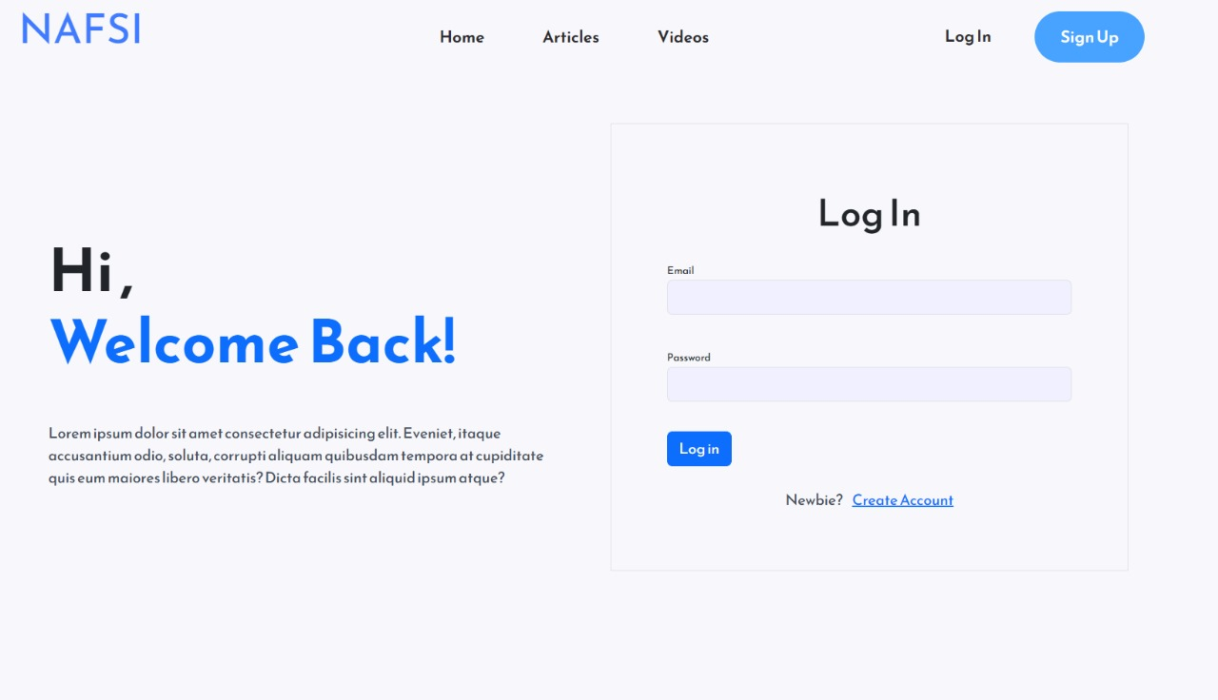
333,000
245,00
386,000
Mercury is the smallest planet
Jupiter is the biggest planet
Despite being red, Mars is cold

Slide 20
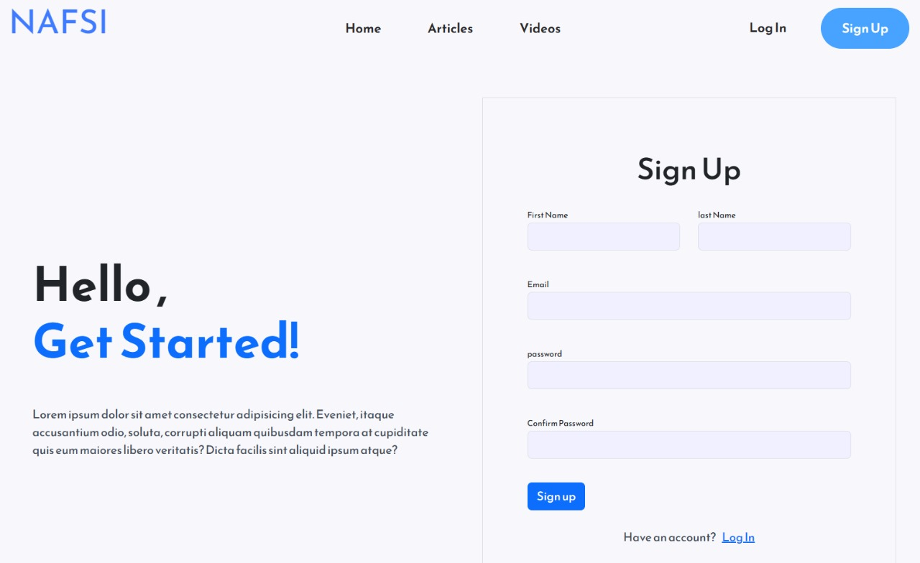
333,000
245,00
386,000
Mercury is the smallest planet
Jupiter is the biggest planet
Despite being red, Mars is cold

Slide 21
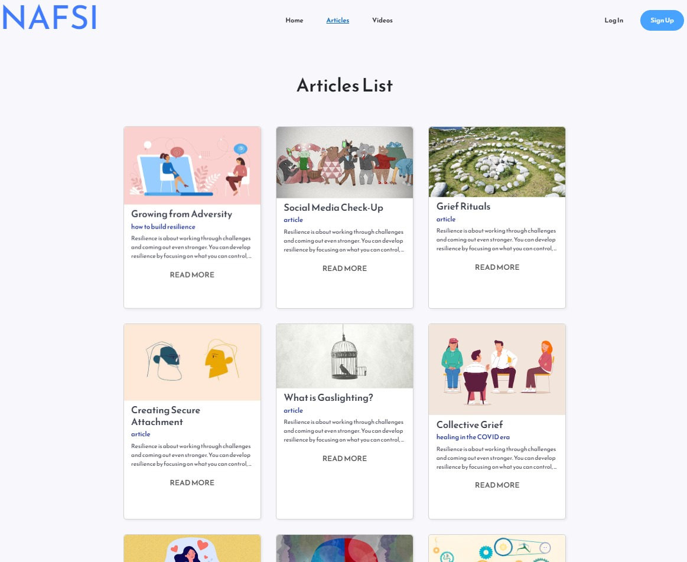
333,000
245,00
386,000
Mercury is the smallest planet
Jupiter is the biggest planet
Despite being red, Mars is cold

Slide 22
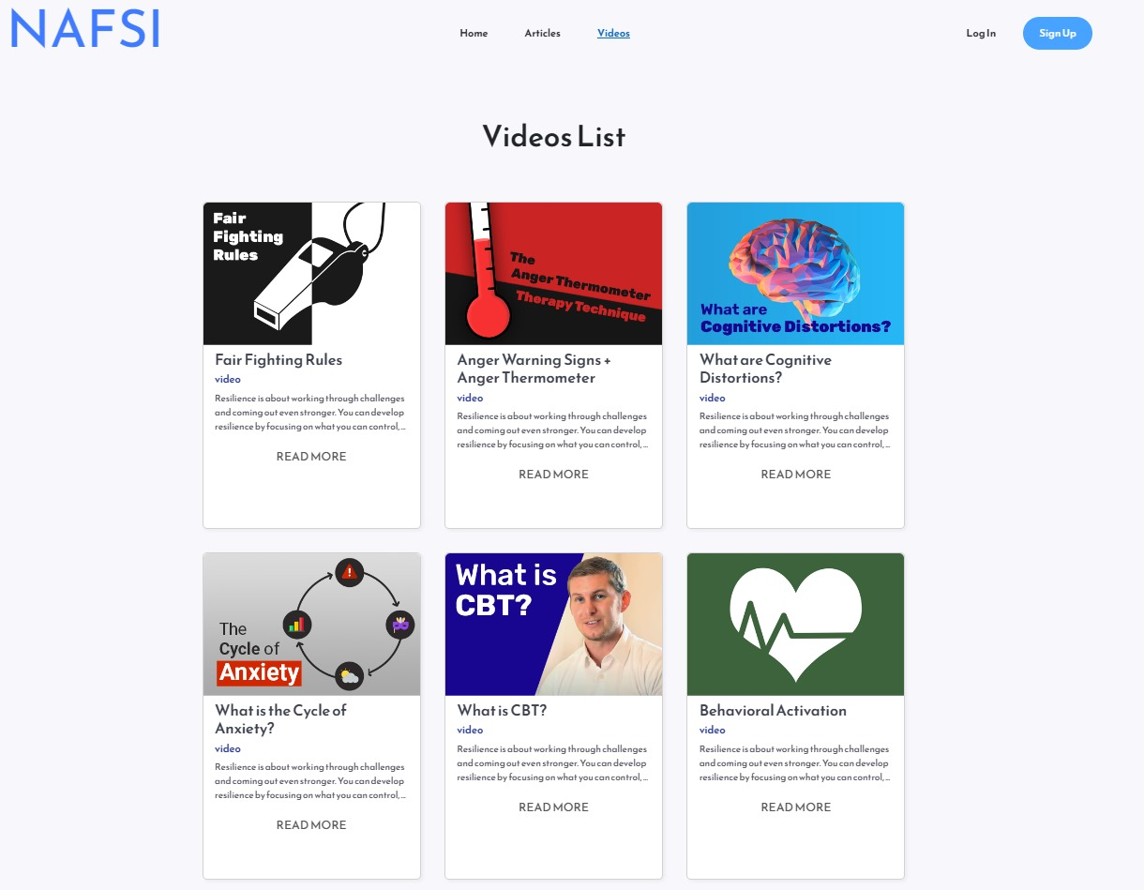
333,000
245,00
386,000
Mercury is the smallest planet
Jupiter is the biggest planet
Despite being red, Mars is cold

Slide 23
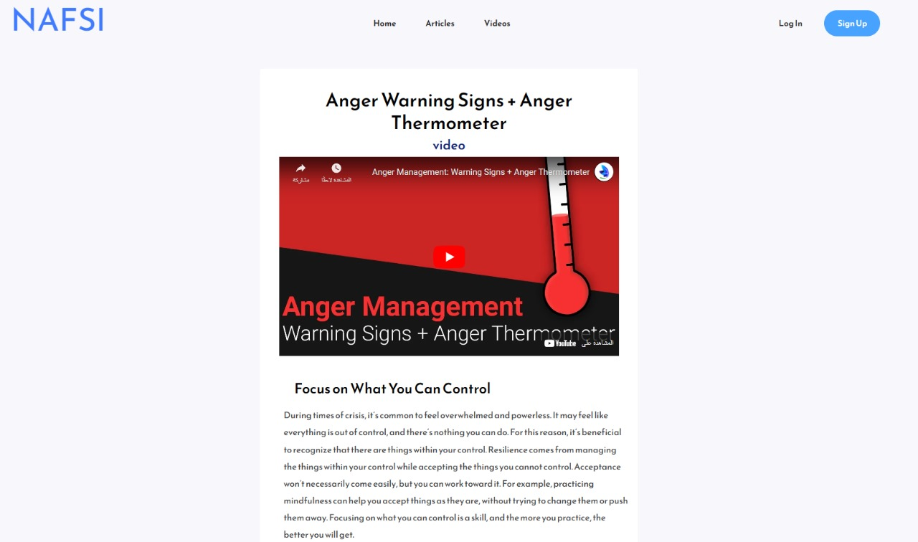
A PICTURE REINFORCES THE CONCEPT
Images reveal large amounts of data, so remember: use an image instead of long texts

Slide 24
Back-End Tech: NodeJS NodeJS is a JavaScript runtime environment framework that can be used for cross-platform development purposes. Since JavaScript is one of the most popular languages in the current context, that popularity has lifted up NodeJS to be one of the most used back-end frameworks as well. Advantages: Based on JavaScript, which is well known to everyone. Easy learning curve and large community. Contains an excellent package manager. Library support. Quick and easy handling of concurrent requests. Simple and scalable. Well established.

Slide 25
DisAdvantages: Some developers may have difficulties working with asynchronous requests. Nested callbacks. Unstable API. Limited standard library

Slide 26
Librariesa and packages: bcryptjs cookie-parser cookieparser dotenv express express-async-handler googleapis joi jsonwebtoken mongoose multer socket.io uuid

Slide 27
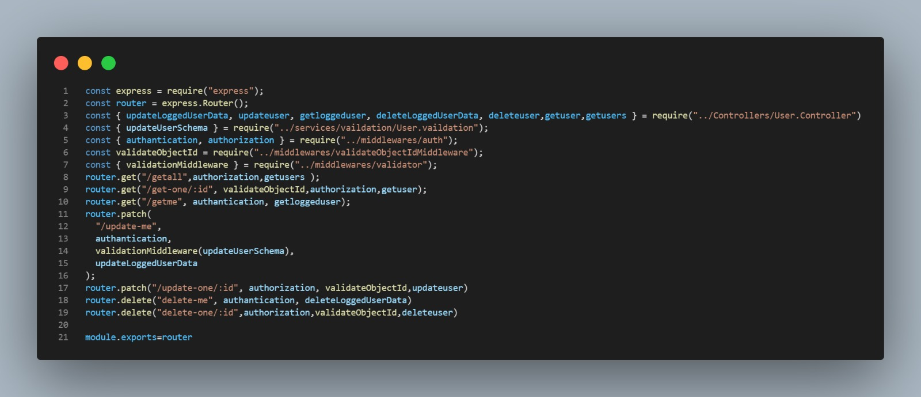
A PICTURE REINFORCES THE CONCEPT
Images reveal large amounts of data, so remember: use an image instead of long texts

Slide 28
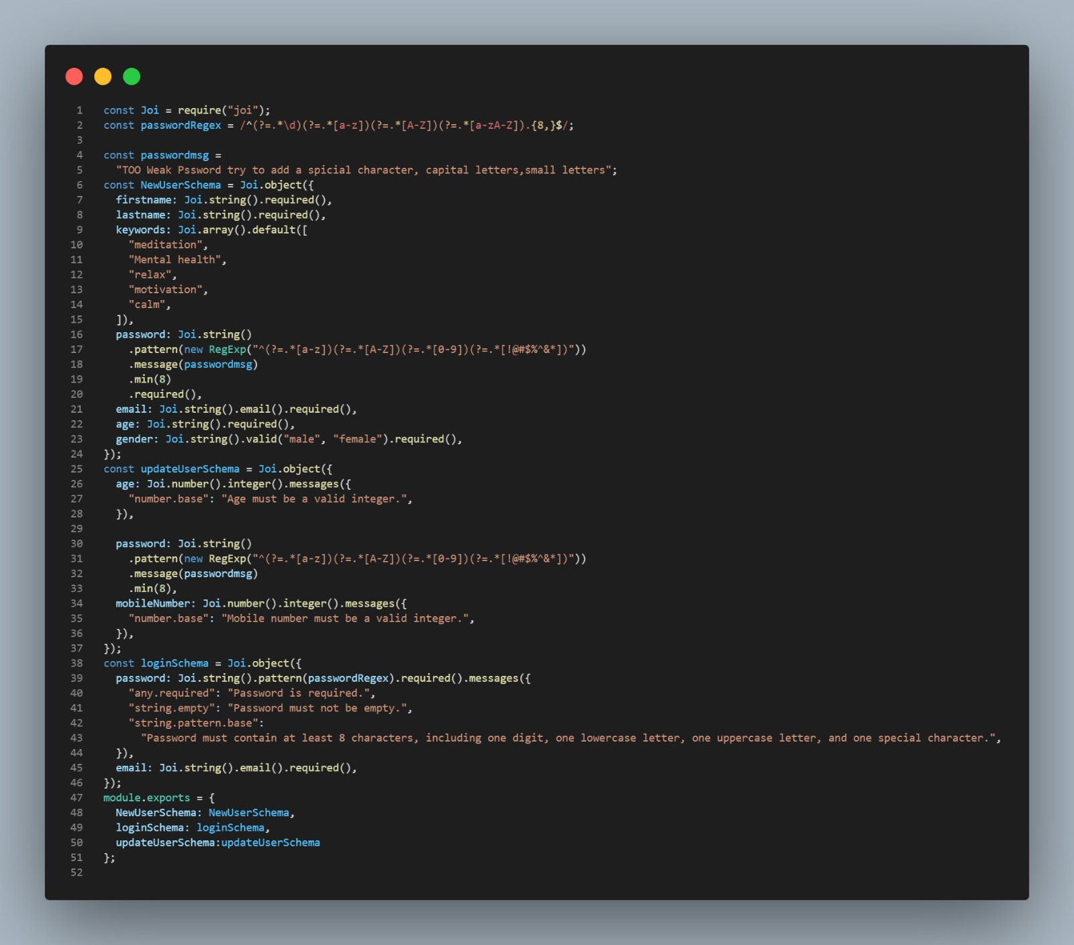
A PICTURE REINFORCES THE CONCEPT
Images reveal large amounts of data, so remember: use an image instead of long texts

Slide 29
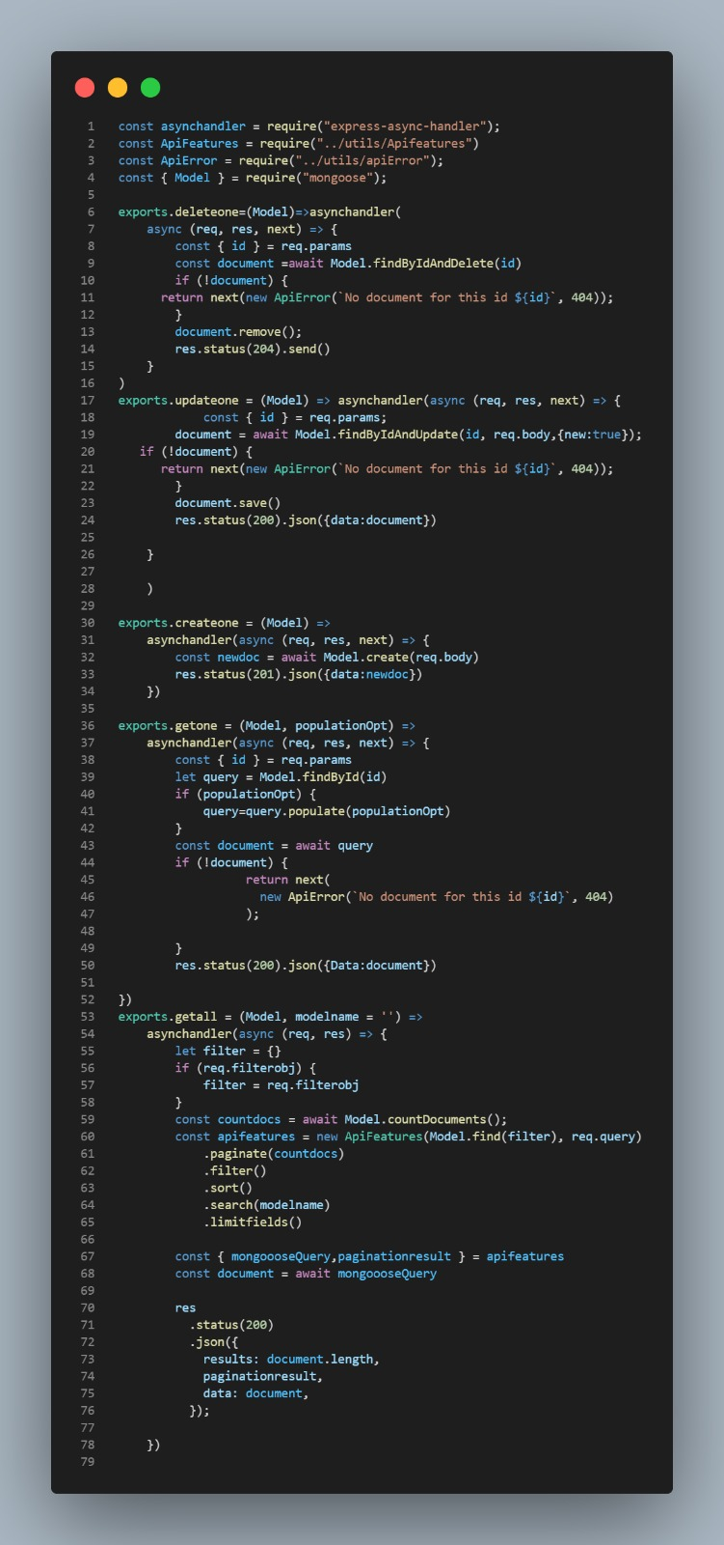
A PICTURE REINFORCES THE CONCEPT
Images reveal large amounts of data, so remember: use an image instead of long texts

Slide 30
Flutter
Flutter is an open source framework developed by google, It is specifically designed for building applications with a focus on the user interface. Flutter provides a wide range of tools, libraries, and pre-built components for developing user interfaces and applications for various platforms, including mobile (iOS and Android), web, and desktop.
Flutter advantages
Single Codebase: Flutter allows you to write a single codebase that runs on both Android and iOS. This reduces development time and effort compared to building separate apps for each platform
Open Source: Flutter is open source, which means it benefits from a large and active community, and there is a wealth of resources, packages, and plugins available.
Cross-Platform Development: Beyond mobile, Flutter can be used for web and desktop development, which means you can extend your app's reach to various platforms.
Access to Native Features: Flutter provides plugins that allow you to access native platform features and APIs when needed, ensuring you are not limited by its framework.

Slide 31
Flutter disadvantages Limited Native Libraries: While Flutter has a rich set of plugins, it may not have plugins for every specific native feature or library, which could require custom development. Version Compatibility: As with any rapidly evolving technology, there can be compatibility issues when updating to newer versions of Flutter, which may require adjustments to your codebase.

Slide 32
Flutter native splash package When your app is opened, there is a brief time while the native app loads Flutter. By default, during this time, the native app displays a white splash screen. This package automatically generates iOS, Android, and Web-native code for customizing this native splash screen background color and splash image. The Issue: The Android system has begun to deal with the home page in Android 12 and newer systems in a way that is somewhat different from older Android systems. This package works well with older Android systems, but the problem was in newer Android systems in which the splash screen did not appear. The Solution: We researched this problem and found two solutions to it The first: Through this package with some modifications available to us through it, but this solution, although it showed the Splash screen, the appearance was not good looking. Second: Through the method used by Native android developers, and this method worked effectively, so we applied it in the project.

Slide 33
Local auth package The Issue: This package was used to lock the application during login using the fingerprint, but there was a problem while running the application on the Android 8 system. The application was crashing. The Solution: Through research, we found a solution to this problem by modifying some of the values of the package, so it works properly on Android systems.

Slide 34

Fonts & colors used
This presentation has been made using the following fonts:
Montserrat
(https://fonts.google.com/specimen/Montserrat)
#ffab40
#85d5e6
#001633
#ffffff

Slide 35
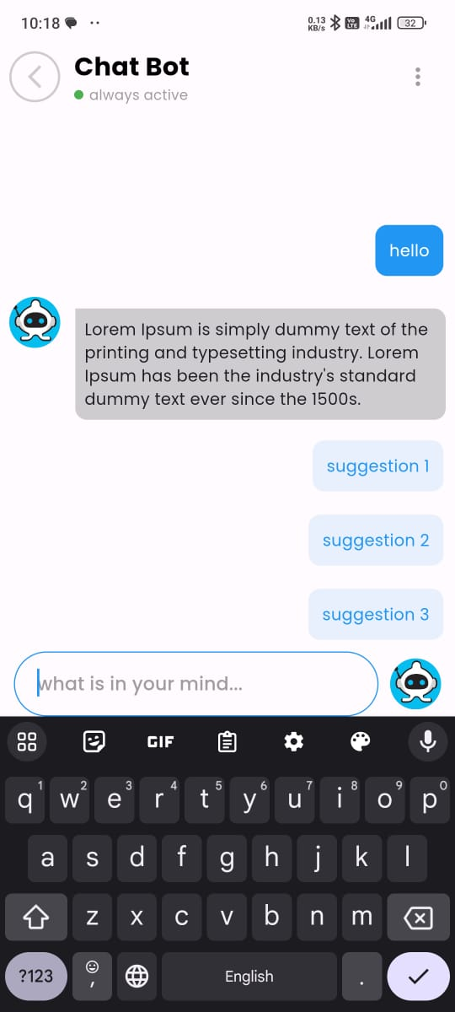
Fonts & colors used
This presentation has been made using the following fonts:
Montserrat
(https://fonts.google.com/specimen/Montserrat)
#ffab40
#85d5e6
#001633
#ffffff

Slide 36

Fonts & colors used
This presentation has been made using the following fonts:
Montserrat
(https://fonts.google.com/specimen/Montserrat)
#ffab40
#85d5e6
#001633
#ffffff

Slide 37
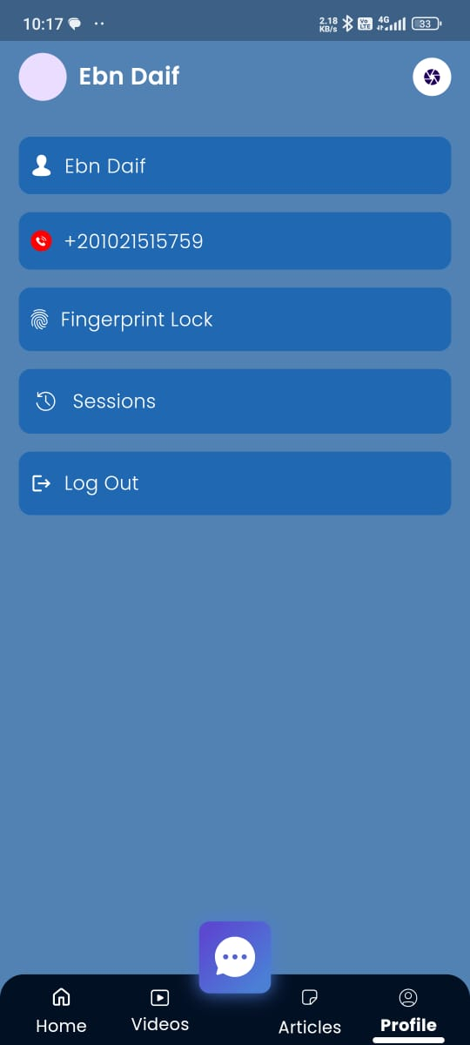
Fonts & colors used
This presentation has been made using the following fonts:
Montserrat
(https://fonts.google.com/specimen/Montserrat)
#ffab40
#85d5e6
#001633
#ffffff

Slide 38
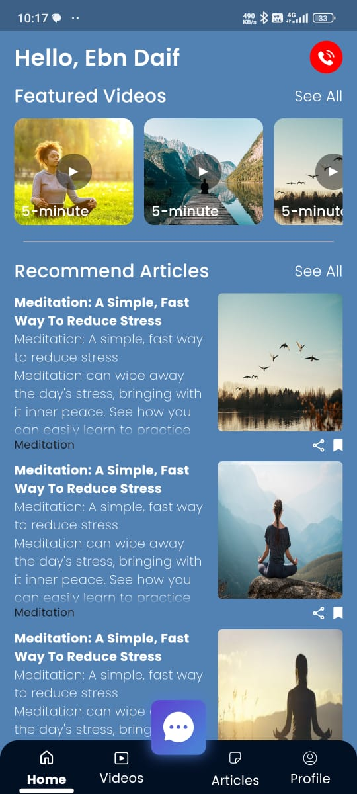
Fonts & colors used
This presentation has been made using the following fonts:
Montserrat
(https://fonts.google.com/specimen/Montserrat)
#ffab40
#85d5e6
#001633
#ffffff

Slide 39
Face Emotion Detection Face emotion detection, also known as facial expression recognition, is a technology that aims to identify and analyze human emotions based on facial expressions. It involves using computer vision techniques and machine learning algorithms to detect and classify emotions such as happiness, sadness, anger, surprise, fear, and disgust. Emotion detection can assist in assessing and monitoring individuals' emotional states, particularly in the context of mental health. It can be used to develop tools for early detection of psychological disorders, track treatment progress, and provide personalized interventions or therapies.

Slide 40
Face emotion detection can play a significant role in promoting mental health and well-being in several ways:
Early Detection of Mental Health Disorders.
Objective Assessment and Monitoring.
Personalized Interventions and Support.
Telehealth and Remote Monitoring.
Research and Insights.

Slide 41
TensorFlow: TensorFlow is an open-source machine learning library widely used for numerical
computation and large-scale machine learning applications. It provides a flexible framework for building and deploying machine learning models, particularly deep learning models.
2. Keras: Keras is a high-level neural networks API written in Python. It is built on top of TensorFlow and provides a user-friendly interface for creating and training deep learning models.
3. Pandas: Pandas is a popular data manipulation and analysis library for Python. It provides data structures and functions for efficiently handling and processing structured data, such as tabular data.
4. NumPy: NumPy is a fundamental library for scientific computing in Python. It provides support for large, multi-dimensional arrays and matrices, along with a vast collection of mathematical functions to operate on these arrays efficiently. NumPy is widely used in numerical computations, data processing, and machine learning algorithms.

Slide 42
tqdm: tqdm is a Python library that creates progress bars for loops and tasks, making it easier to monitor the progress of lengthy operations. It provides a simple and convenient way to add progress bars to your code, enhancing the user experience by providing visual feedback on the progress of time-consuming tasks. scikit-learn: scikit-learn is a machine learning library for Python that provides a wide range of algorithms for classification, regression, clustering, and dimensionality reduction. It offers a consistent API and a rich set of functionalities for tasks such as data preprocessing, model evaluation, and model selection. OpenCV: OpenCV (Open Source Computer Vision Library) is a popular computer vision library that provides a comprehensive set of functions and algorithms for image and video processing. OpenCV supports a wide range of tasks, including object detection, image recognition, facial recognition, and video analysis. It is widely used in various industries, including robotics, surveillance, and augmented reality.

Slide 43

Pillow: Pillow is a powerful image processing library for Python. It builds on top of the Python Imaging Library (PIL) and provides an easy-to-use interface for opening, manipulating, and saving many image file formats. Pillow offers a broad range of image processing operations, such as resizing, cropping, filtering, and blending, making it a valuable tool for image-related tasks in data analysis and machine learning. Kaggle: Kaggle is a popular online platform for data science and machine learning competitions. It provides a community-driven environment where data scientists and machine learning enthusiasts can access and collaborate on datasets, participate in competitions, and share their work. Kaggle hosts a vast collection of datasets and provides a platform for running code in notebooks. Jupyter Notebook: Jupyter Notebook is an open-source web application that allows you to create and share documents that contain live code, visualizations, and explanatory text. It supports various programming languages, including Python, and provides an interactive environment for data exploration, prototyping, and data visualization. Jupyter Notebook is widely used in data analysis, machine learning, and scientific computing due to its flexibility and ease of use.

Slide 44
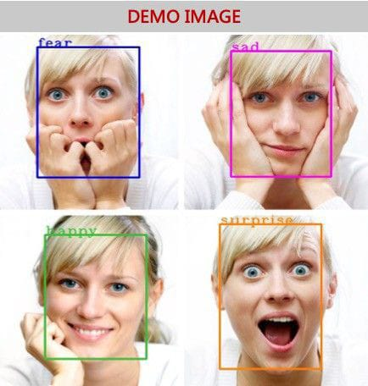

Slide 45
Thanks

